Slide 1

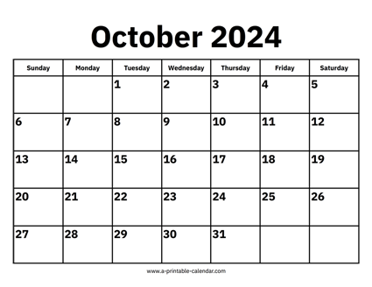

CS 310 : Scalable Software Architectures
Class session on Tuesday, October 1st
Notes:
Focus this week:
Relational databases
Class sessions *are* being recorded this week
Will be available under Panopto on Canvas
Project 01 due Wednesday Oct 9th @ 11:59pm
Build a simple photo app using AWS
Part 01 has been released, configuration of AWS
Part 02 to be released, client-side programming
Office hours started Monday
Optional SQL homework will be posted

Slide 2
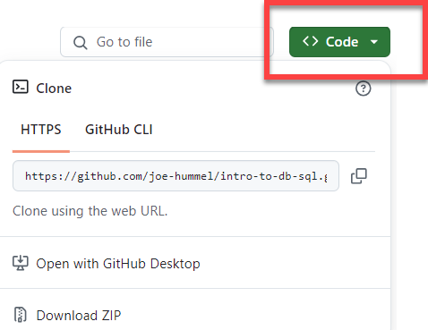
Goals for today
Summarize key points of lecture
Write SQL
Using sqlite3, a local file-based DBMS (e.g. used in mobile apps)
Using MySQL running in AWS
Work with Docker
You need Docker Desktop installed
Download files from GitHub:
https://github.com/joe-hummel/intro-to-db-sql
Clone repo or download ZIP

Slide 3
SQL + DBMS
SELECT * FROM ...;
Database software
Database
SQL program
Database Management System (DBMS)
(MySql, Oracle, SQLite, SQL Server, …)

Slide 4
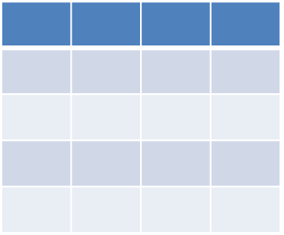
Select
For retrieving data from a database
General format:
The result is *always* a table
SELECT <<the data you want>>
FROM <<table>>
[ JOIN <<table> ON <<condition>> ]
[ WHERE <<condition(s)>> ]
[ GROUP BY <<one or more fields>> ]
[ HAVING <<condition(s)>> ]
[ ORDER BY <<one or more fields>> ]
;
optional
Notes:
Ignore the optional stuff for now…

Slide 5
Group by
Group By Ride_Date
Sum(Num_Riders)
Ride_Date
41280,12/22/2017,W,6104
41000,12/18/2017,W,3636
40280,12/02/2017,A,1270
40140,12/18/2017,W,1759
40690,12/03/2017,U,499
41660,12/03/2017,A,8615
40180,12/03/2017,U,442
40250,12/22/2017,A,1353
40120,12/07/2017,W,3353
41420,12/22/2017,W,6034
40270,12/18/2017,A,887
41450,12/18/2017,W,9639
41210,12/02/2017,W,3210
40010,12/22/2017,U,641
41160,12/22/2017,U,621
40720,12/18/2017,W,613
41280,12/22/2017,W,6104
40250,12/22/2017,A,1353
41420,12/22/2017,W,6034
40010,12/22/2017,U,641
41160,12/22/2017,U,621
14753
41000,12/18/2017,W,3636
40140,12/18/2017,W,1759
40270,12/18/2017,A,887
41450,12/18/2017,W,9639
40720,12/18/2017,W,613
16534
40280,12/02/2017,A,1270
41210,12/02/2017,W,3210
4480
40690,12/03/2017,U,499
41660,12/03/2017,A,8615
40180,12/03/2017,U,442
9556
40120,12/07/2017,W,3353
3353

Slide 6
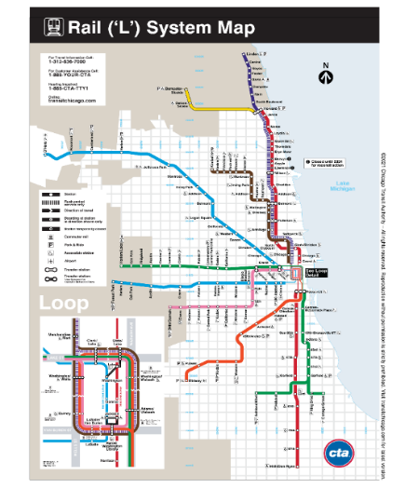
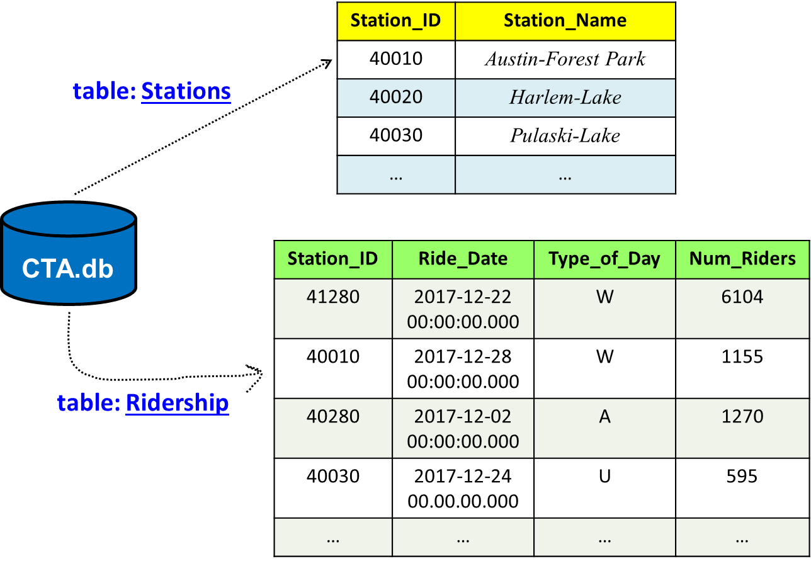
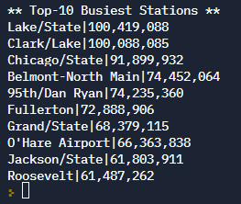
Join
select "** Top-10 Busiest Stations **";
Select Station_Name, Sum(Num_Riders)
From Stations
Join Ridership On Stations.Station_ID = Ridership.Station_ID
Group By Stations.Station_ID
Order By Sum(Num_Riders) DESC
Limit 10;
Notes:
To get the commas in the output with SQLITE, you need to use printf, as in
Select Station_Name, printf('%,d', Sum(Num_Riders))

Slide 7

Getting the necessary software
Download files you need for today
https://github.com/joe-hummel/intro-to-db-sql
Clone repo or download ZIP
Make sure Docker Desktop is running
Build Docker image and run container:
Linux/Mac/Windows WSL:
Open terminal, navigate to folder
chmod 755 *.bash
./docker-build.bash
./docker-run.bash
Windows:
Open Powershell, navigate to folder
.\docker-build.bat
.\docker-run.bat

Slide 8
Common docker errors
"docker" command not found
Uninstall and reinstall Docker Desktop
When you try to build, you are not authorized
docker login -u docker-username
When you try to run, you get errors like "bash: $\r: command not found"
If you see the docker> prompt, type exit
((Get-Content .bashrc) -join "`n") + "`n" | Set-Content -NoNewLine .bashrc

Slide 9
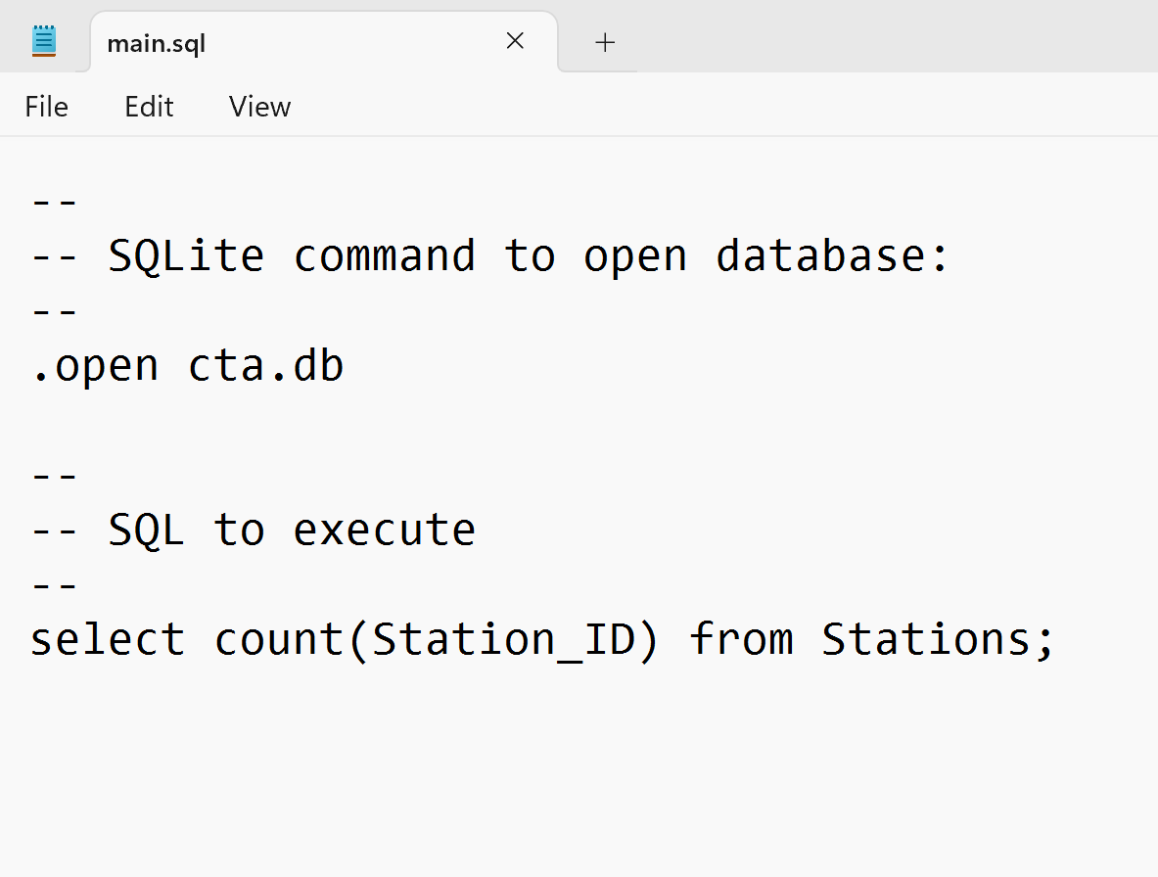
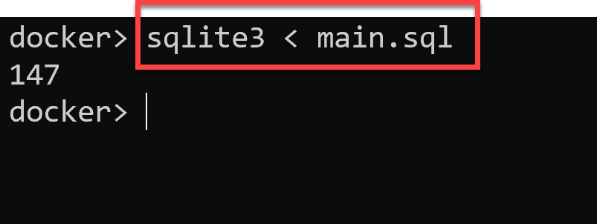
Working with sqlite3
Open "main.sql" in a text editor
Write query and save changes
Run via docker container:

Slide 10
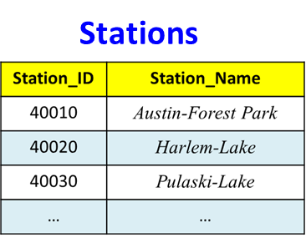
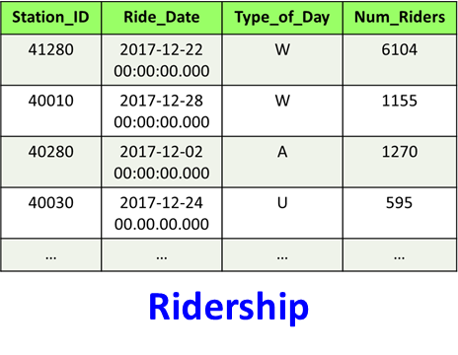
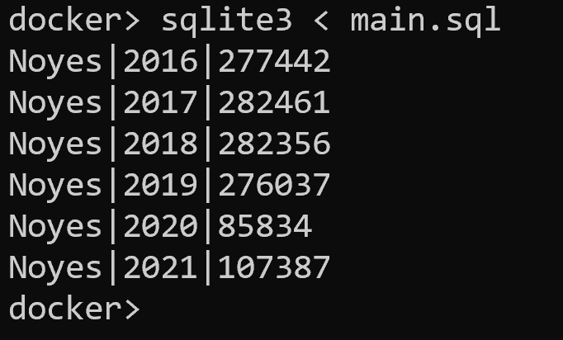
Exercise
What is the yearly ridership for the "Noyes" station?
Most DBMS have Year( ) function, sqlite does not
SELECT Station_Name,
strftime('%Y', Ride_Date) as Year,
Sum(Num_Riders)
FROM ?
INNER JOIN ?
WHERE ?
GROUP BY ?
ORDER BY ?
;
Notes:
select Station_Name, strftime('%Y', Ride_Date) as Year, Sum(Num_Riders)
from Stations
Inner join Ridership on Stations.Station_ID = Ridership.Station_ID
where Station_Name = 'Noyes'
group by Year
order by Year ASC;

Slide 11
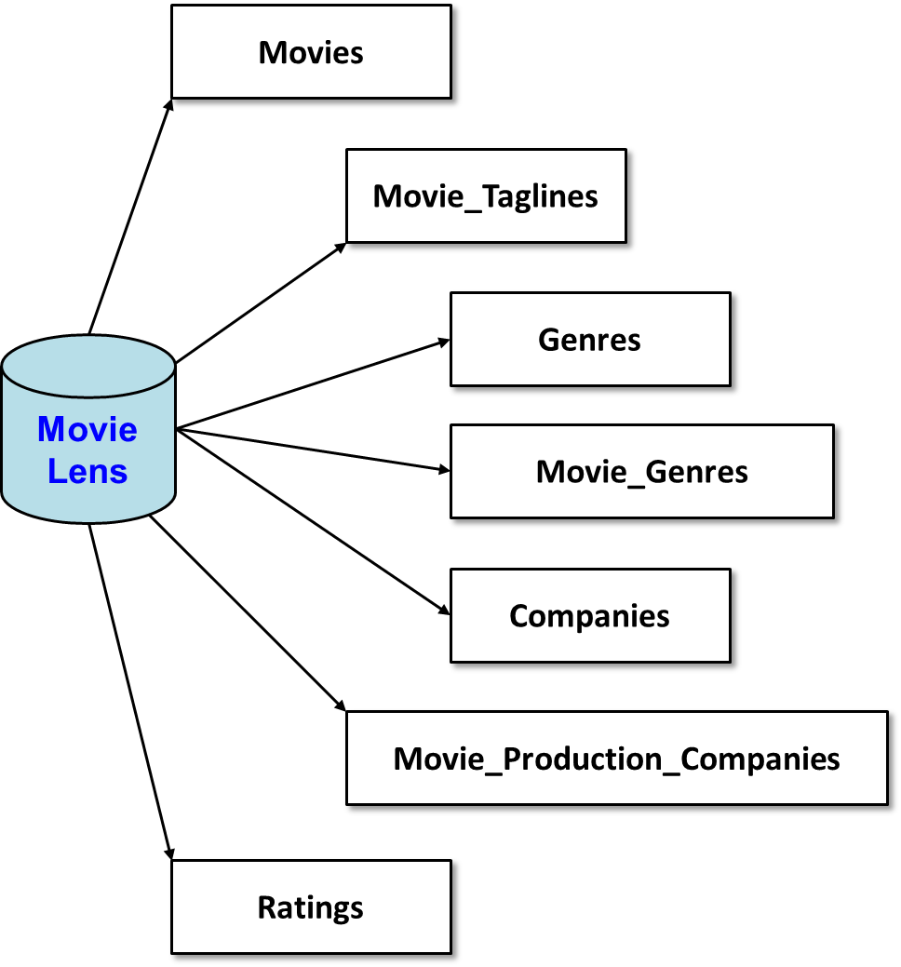
MovieLens database
MovieLens
https://movielens.org/

Slide 12
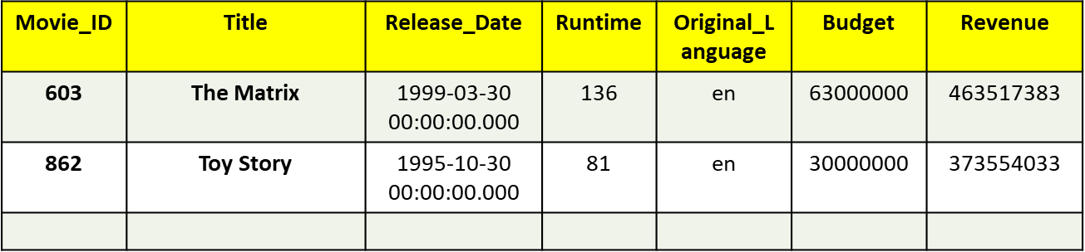
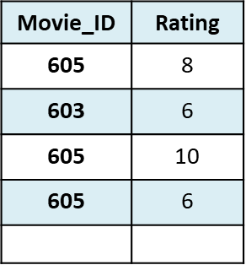
Exercises
How many movies are there? [45,431]
How many ratings are there? [100,004]
What is the movie id for 'The Matrix'? [ 603 ]
Which movie titles contain 'matrix'? [ there are 7 ]
Movies
Ratings

Slide 13
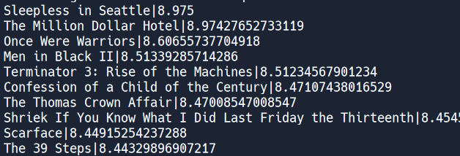
Exercise
--
-- Retrieve the top-10 movies ranked by average rating;
-- retrieve the title and average rating. Consider only
-- movies with more than 100 reviews.
--
SELECT ?
FROM ?
INNER JOIN ?
GROUP BY ?
HAVING ?
ORDER BY ?
LIMIT 10;
Movies
Ratings
Notes:
SELECT Title, avg(Rating) as AvgRating
FROM Movies
INNER JOIN Ratings ON Movies.Movie_ID = Ratings.Movie_ID
GROUP BY Ratings.Movie_ID
HAVING Count(Rating) > 100
ORDER BY AvgRating DESC, Title ASC
LIMIT 10;

Slide 14
Solution
--
-- Retrieve the top-10 movies ranked by average rating;
-- retrieve the title and average rating. Consider only
-- movies with more than 100 reviews.
--
SELECT Title, avg(Rating) as AvgRating
FROM Movies
INNER JOIN Ratings ON Movies.Movie_ID = Ratings.Movie_ID
GROUP BY Ratings.Movie_ID
HAVING Count(Rating) > 100
ORDER BY AvgRating DESC, Title ASC
LIMIT 10;

Slide 15
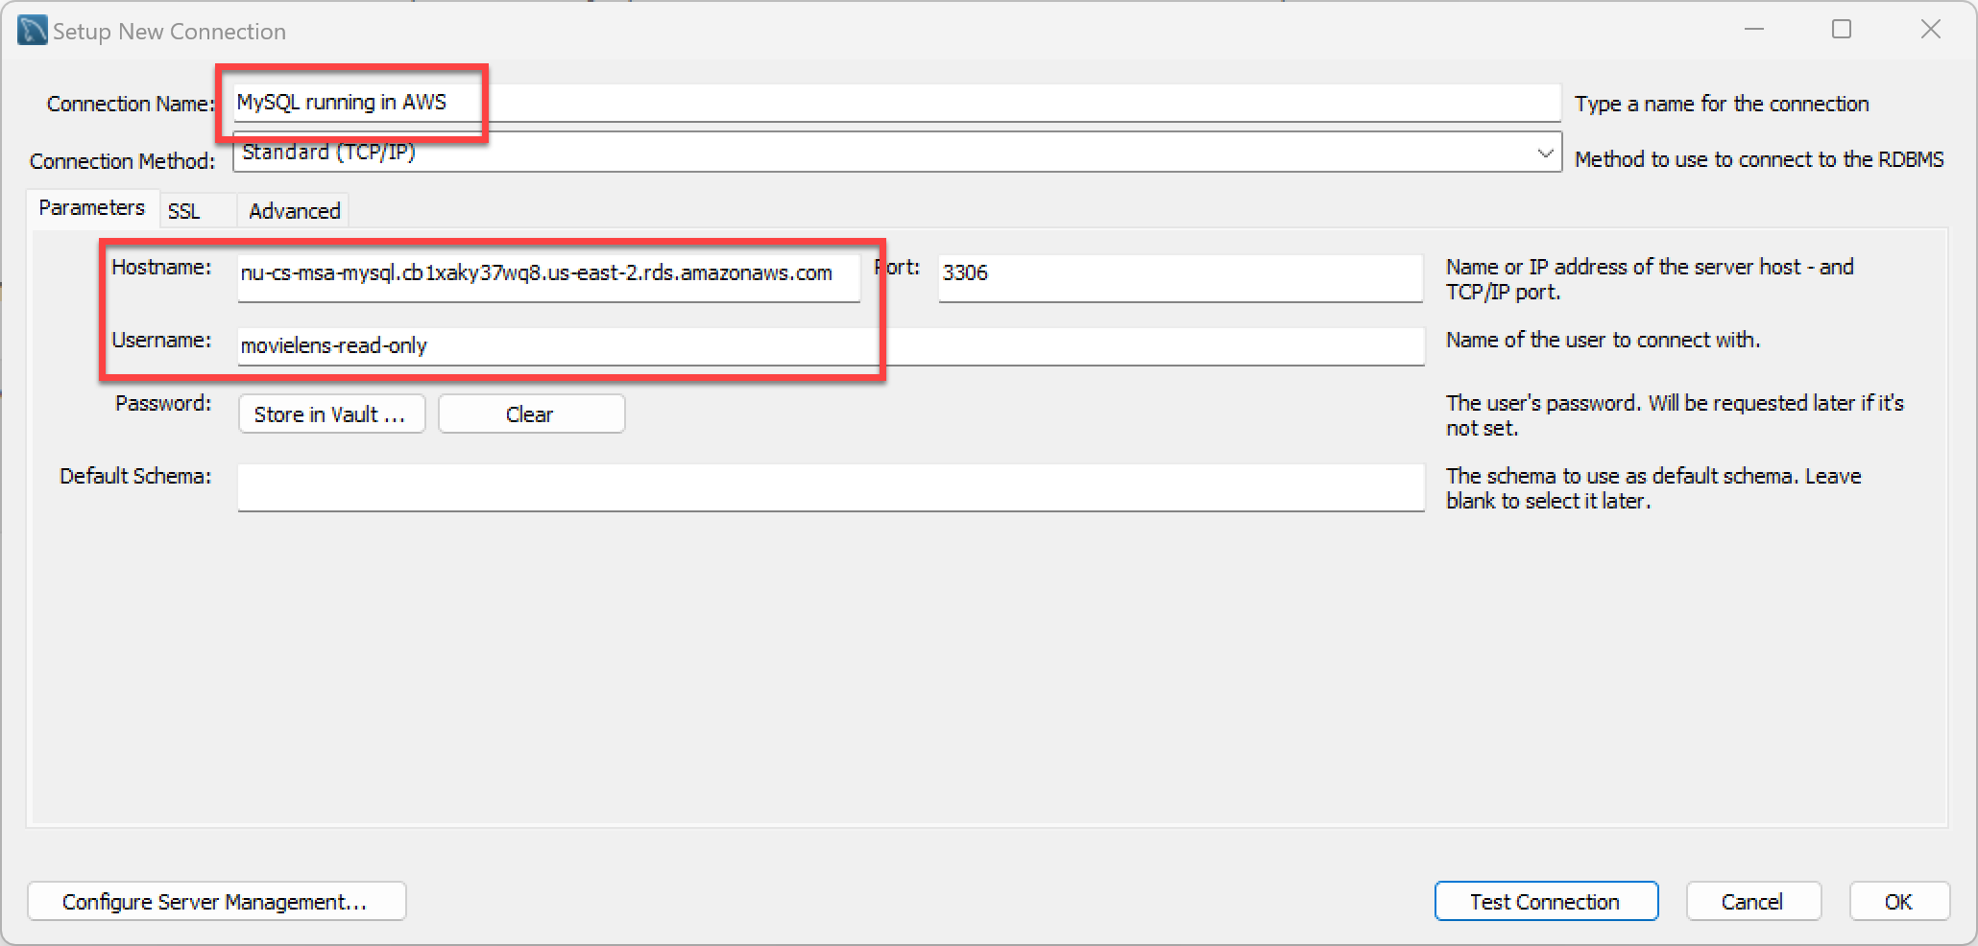


Demo: My SQL Workbench
In the projects we're going to work with MySQL running in AWS
Need different software to connect to DB server
Notes:
nu-cs-msa-mysql.cb1xaky37wq8.us-east-2.rds.amazonaws.com
movielens-read-only
abc123!!

Slide 16
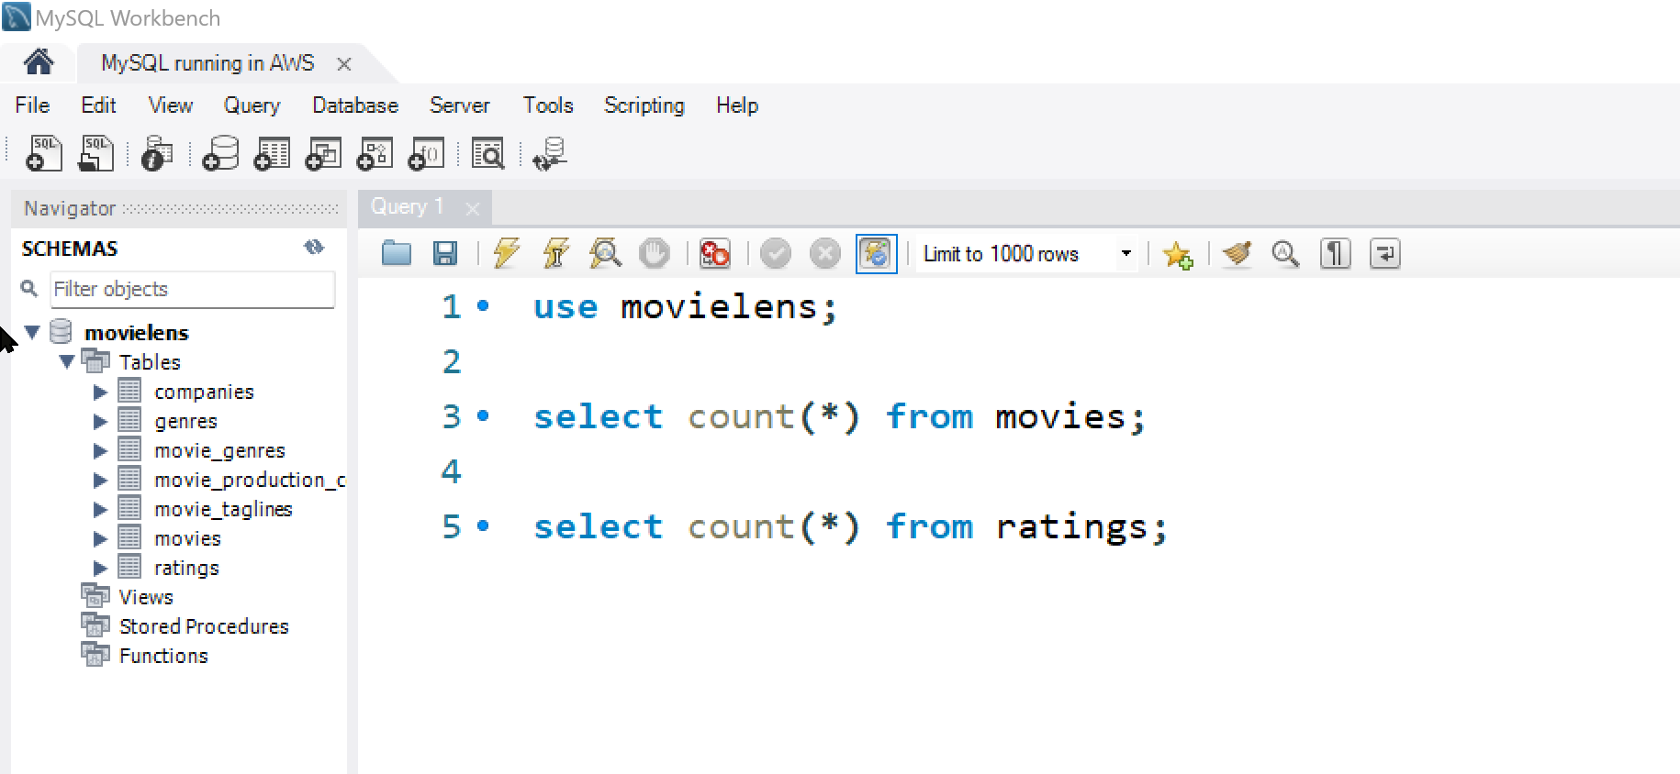


Slide 17
That's it, thank you!

Slide 18
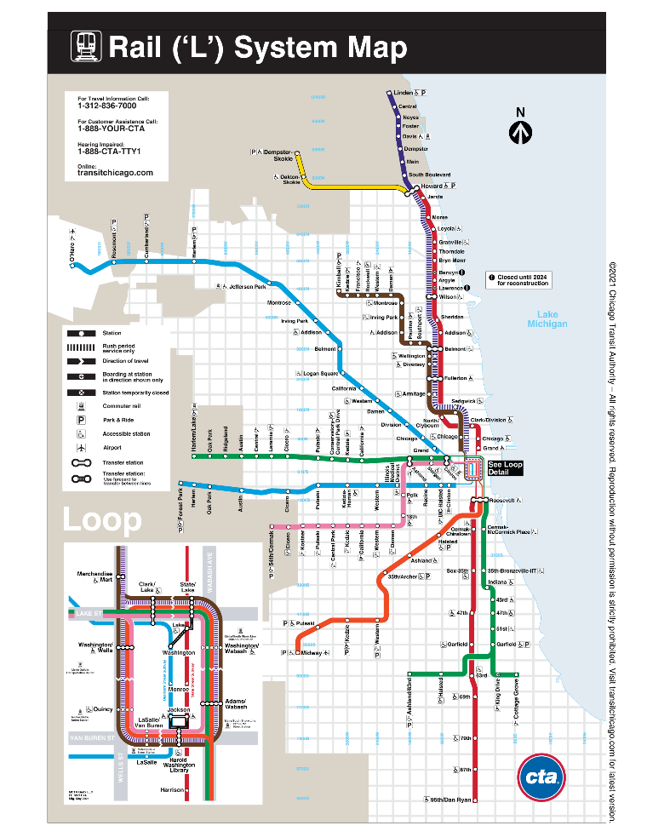

Slide 19
Station_ID | Station_Name
40710 | Chicago/Franklin
… | …
Stations
CTA database
Stop_ID | Station_ID | Stop_Name | Direction | ADA | Latitude | Longitude
30137 | 40710 | Chicago (Kimball-Linden-bound) | N | 1 | 41.89681 | -87.635924
30138 | 40710 | Chicago (Loop-bound) | S | 1 | 41.89681 | -87.635924
… | … | … | … | … | … | …
Stops
CTA
Lines
Line_ID | Color
… | …
4 | Brown
5 | Purple
6 | Purple-Express
… | …
Stop_ID | Line_ID
… | …
30137 | 4
30137 | 6
30138 | 4
30138 | 6
… | …
Ridership
LinesPerStop
Station_ID | Ride_Date | Type_of_Day | Num_Riders
… | … | … | …
40710 | 2001-02-28 00:00:00.000 | W | 4206
… | … | … | …

Slide 20
Movies
Movie_Taglines
Genres
Movie Lens
Movie_Genres
Companies
Movie_Production_Companies
Ratings

Slide 21
Movie_ID | Title | Release_Date | Runtime | Original_Language | Budget | Revenue
603 | The Matrix | 1999-03-30 00:00:00.000 | 136 | en | 63000000 | 463517383
862 | Toy Story | 1995-10-30 00:00:00.000 | 81 | en | 30000000 | 373554033
Movies
Movie_ID | Tagline
603 | Welcome to the Real World.
605 | Everything that has a beginning has an end.
Movie_Taglines
Movie Lens
Ratings
Movie_ID | Rating
605 | 8
603 | 6
605 | 10
605 | 6

Slide 22
Company_ID | Company_Name
1885 | Silver Pictures
6194 | Warner Bros.
Movie_ID | Company_ID
603 | 1885
603 | 6194
862 | 3
Companies
Movie_Production_Companies
Movie_ID | Genre_ID
862 | 16
862 | 35
603 | 28
603 | 878
Movie Lens
Movie_Genres
Genres
Genre_ID | Genre_Name
28 | Action
878 | Science Fiction
16 | Animation
35 | Comedy

